Slide 1
Environment A
(genome A)
(x10)
no
Protein production energy costs?
Environment A
(genome A)
(x10)
yes
Environment B
(genome B)
(x10)
null
Environment A
(genome A)
(x10)
no
low
(0.001)
Mutation rates?
Protein production energy costs?
Environment A
(genome A)
(x10)
yes
Environment B
(genome B)
(x10)
high
(0.01)
Environment A
(genome A)
(x10)
no
Protein production energy costs?
Environment A
(genome A)
(x10)
yes
Environment B
(genome B)
(x10)

Slide 2
a. Genetic regulatory network
b. Metabolic network
-
1
20
local
environment
cytoplasm
-
20
Prom
BS₁
TF₁ (20)
E₁ (20 → 5)
Pump₁ (20)
P1
20
5
E1
Op. 1
-
Metabolic pathway 1
2
22
P2
22
E2
3
22
Metabolic pathway 2
-
Prom
BS₂
TF₂ (22)
E₂ (22 → 3)
Pump₂ (22)
cell’s membrane
Op. 2

Slide 3
a. Produced proteins
b. Inherited proteins
c. Inner cell metabolites
Op. 1
Op. 2
#20
#5
#22
#3
Concentration (in Z units = 10⁻⁸M)
Cell’s division
d. External metabolites
e. Energy carrier
f. Cell’s score
Little energy
drops
Concentration (in Z units = 10⁻⁸M)
#5
#3
Time since cell’s birth (x100 minutes)
Time since cell’s birth (x100 minutes)
Time since cell’s birth (x100 minutes)

Slide 4
Extinction time in environment A,
with null mutation rates
* (p-value = 0.017)
Simulation time
Cell’s energy model

Slide 5
a. Extinction time in environment A,
without protein production costs
b. Extinction time in environment A,
with protein production costs
* (p-value = 0.041)
(p-value = 0.623)
80%
exctinction
0%
exctinction
Simulation time
Simulation time
80%
exctinction
100%
exctinction
Mutation rates
Mutation rates

Slide 6
Proportion of simulations
that did not lose genetic regulation
Proportion of simulations
that kept regulation
Null
mutation rates
Low
mutation rates
High
mutation rates

Slide 7
Mean extinction time
(except for simulations reaching 500.000t)
Extinction time vs.
proportion of simulations that kept regulation
Mean extinction time
(simulation time-steps)
Proportion of simulations
that kept regulation
Null
mutation rates
Low
mutation rates
High
mutation rates
Mean extinction time (simulation time-steps)

Slide 8
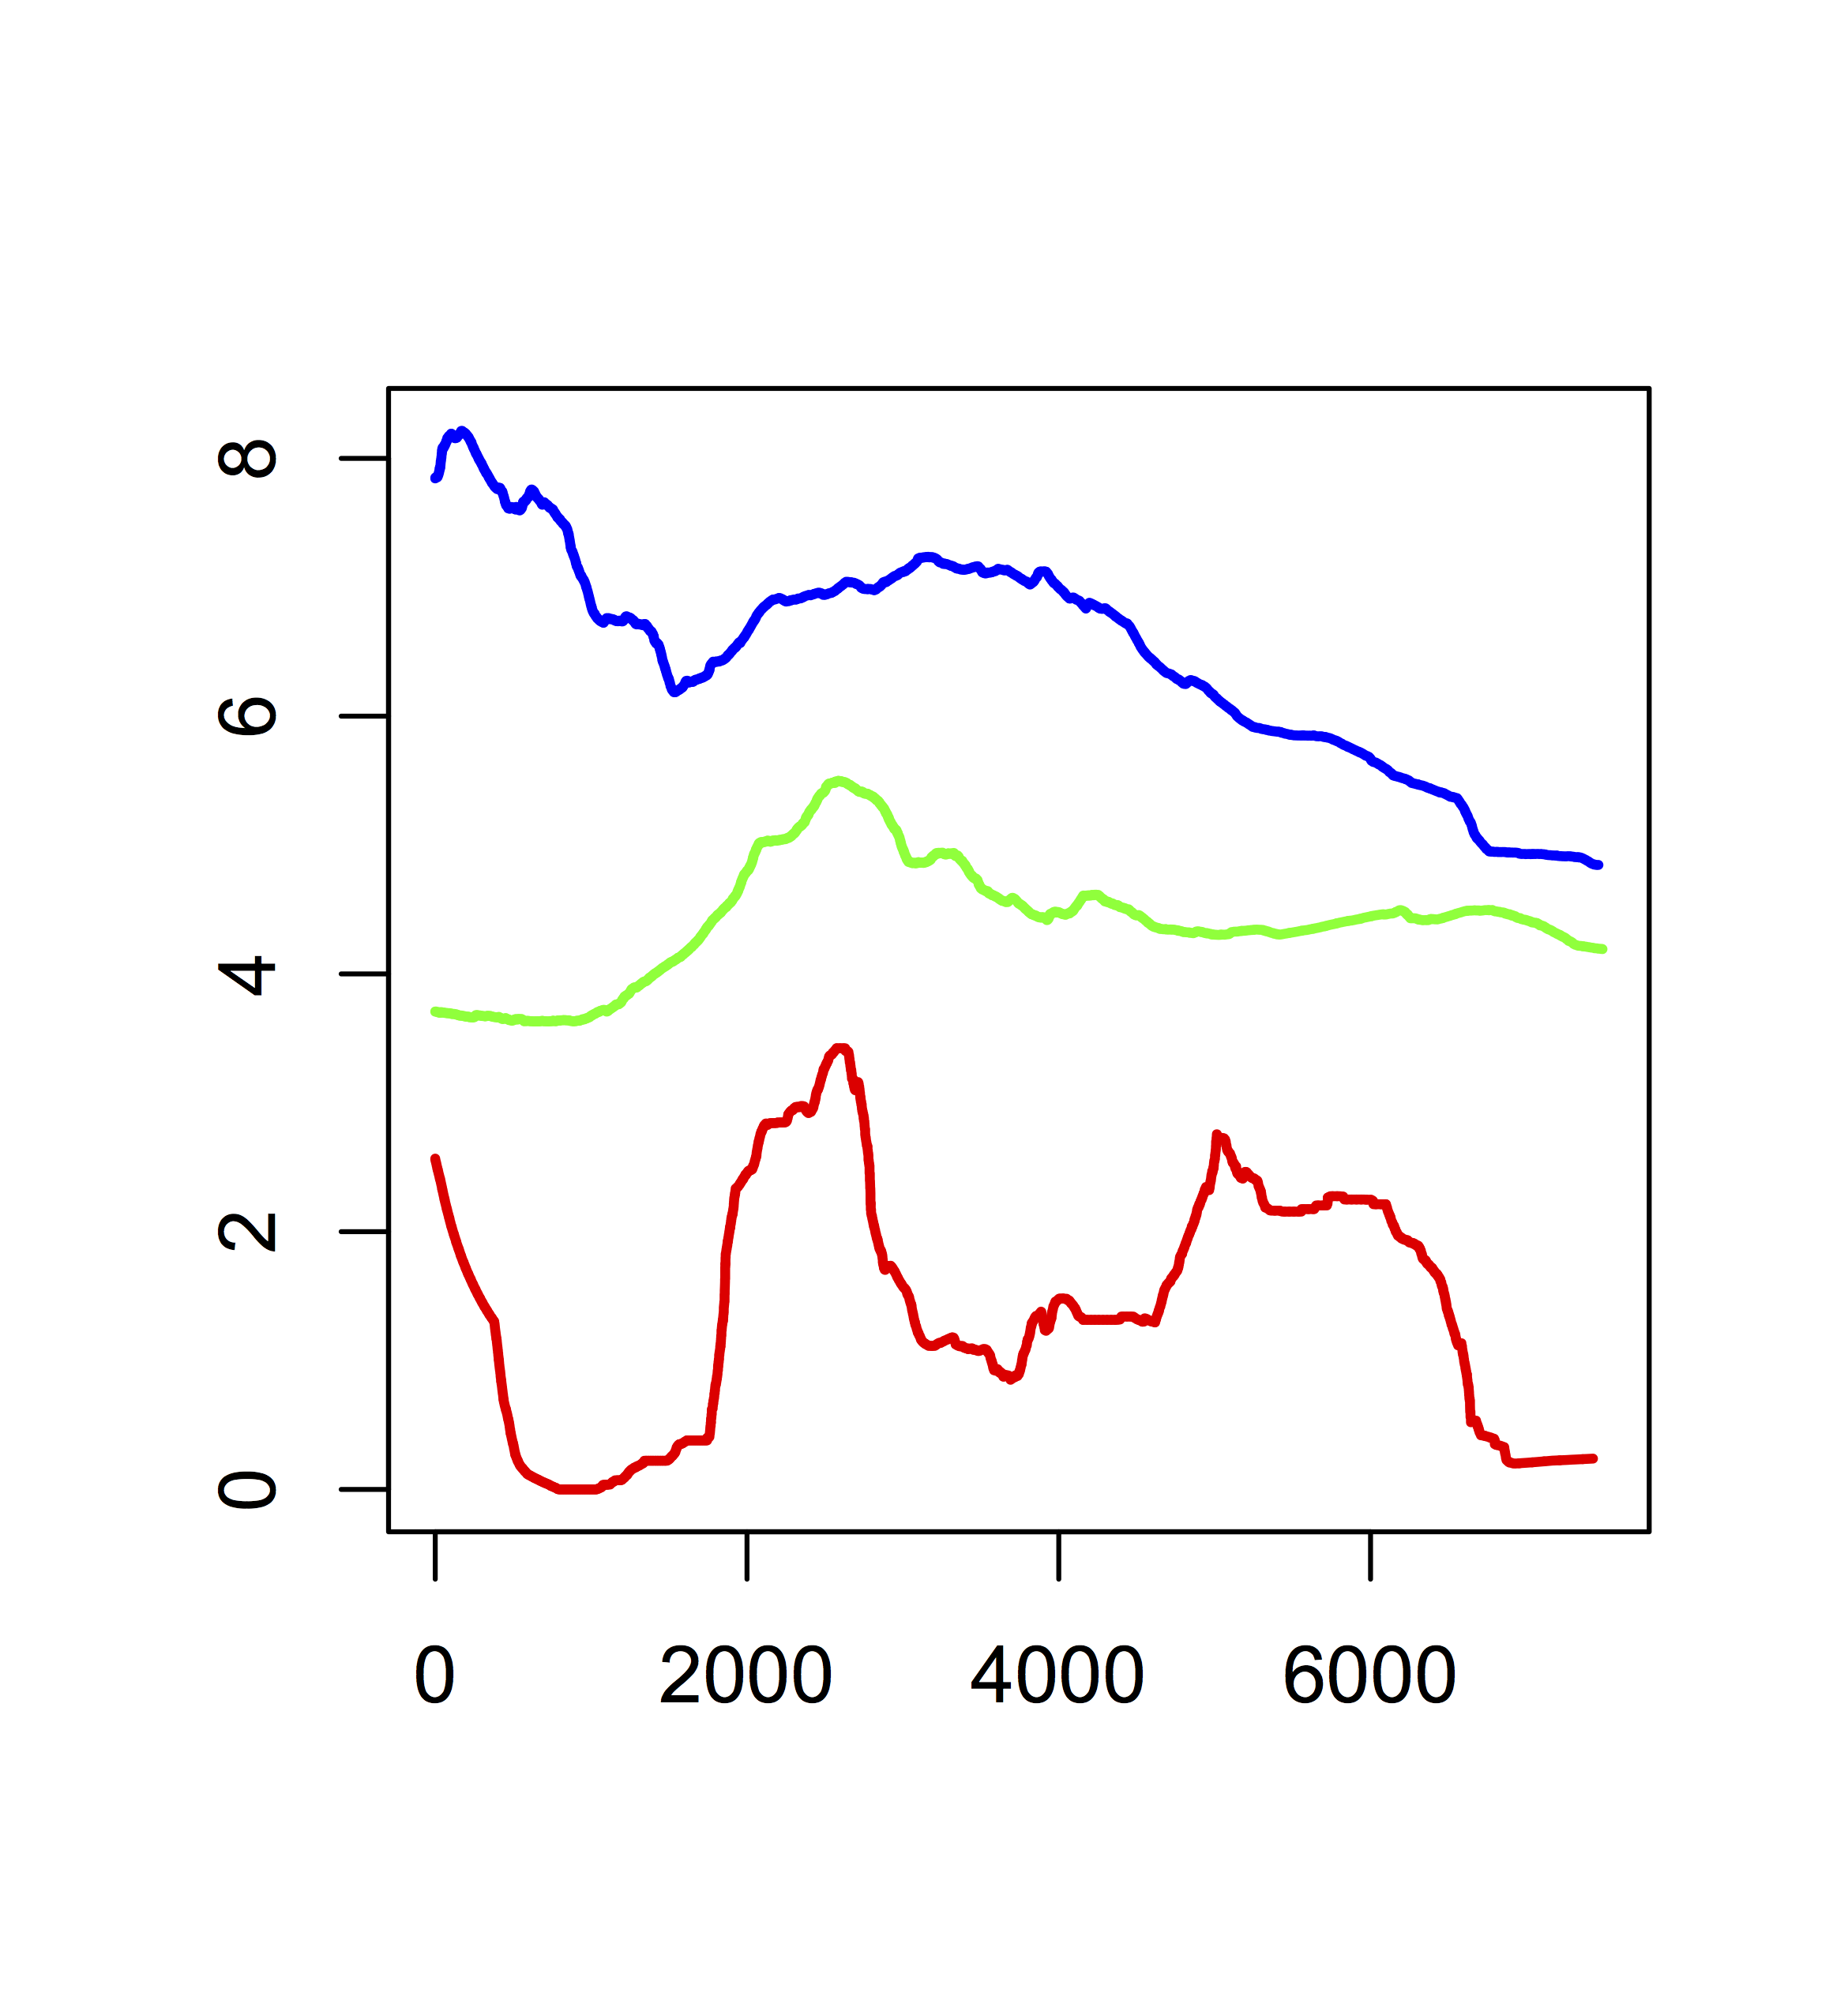
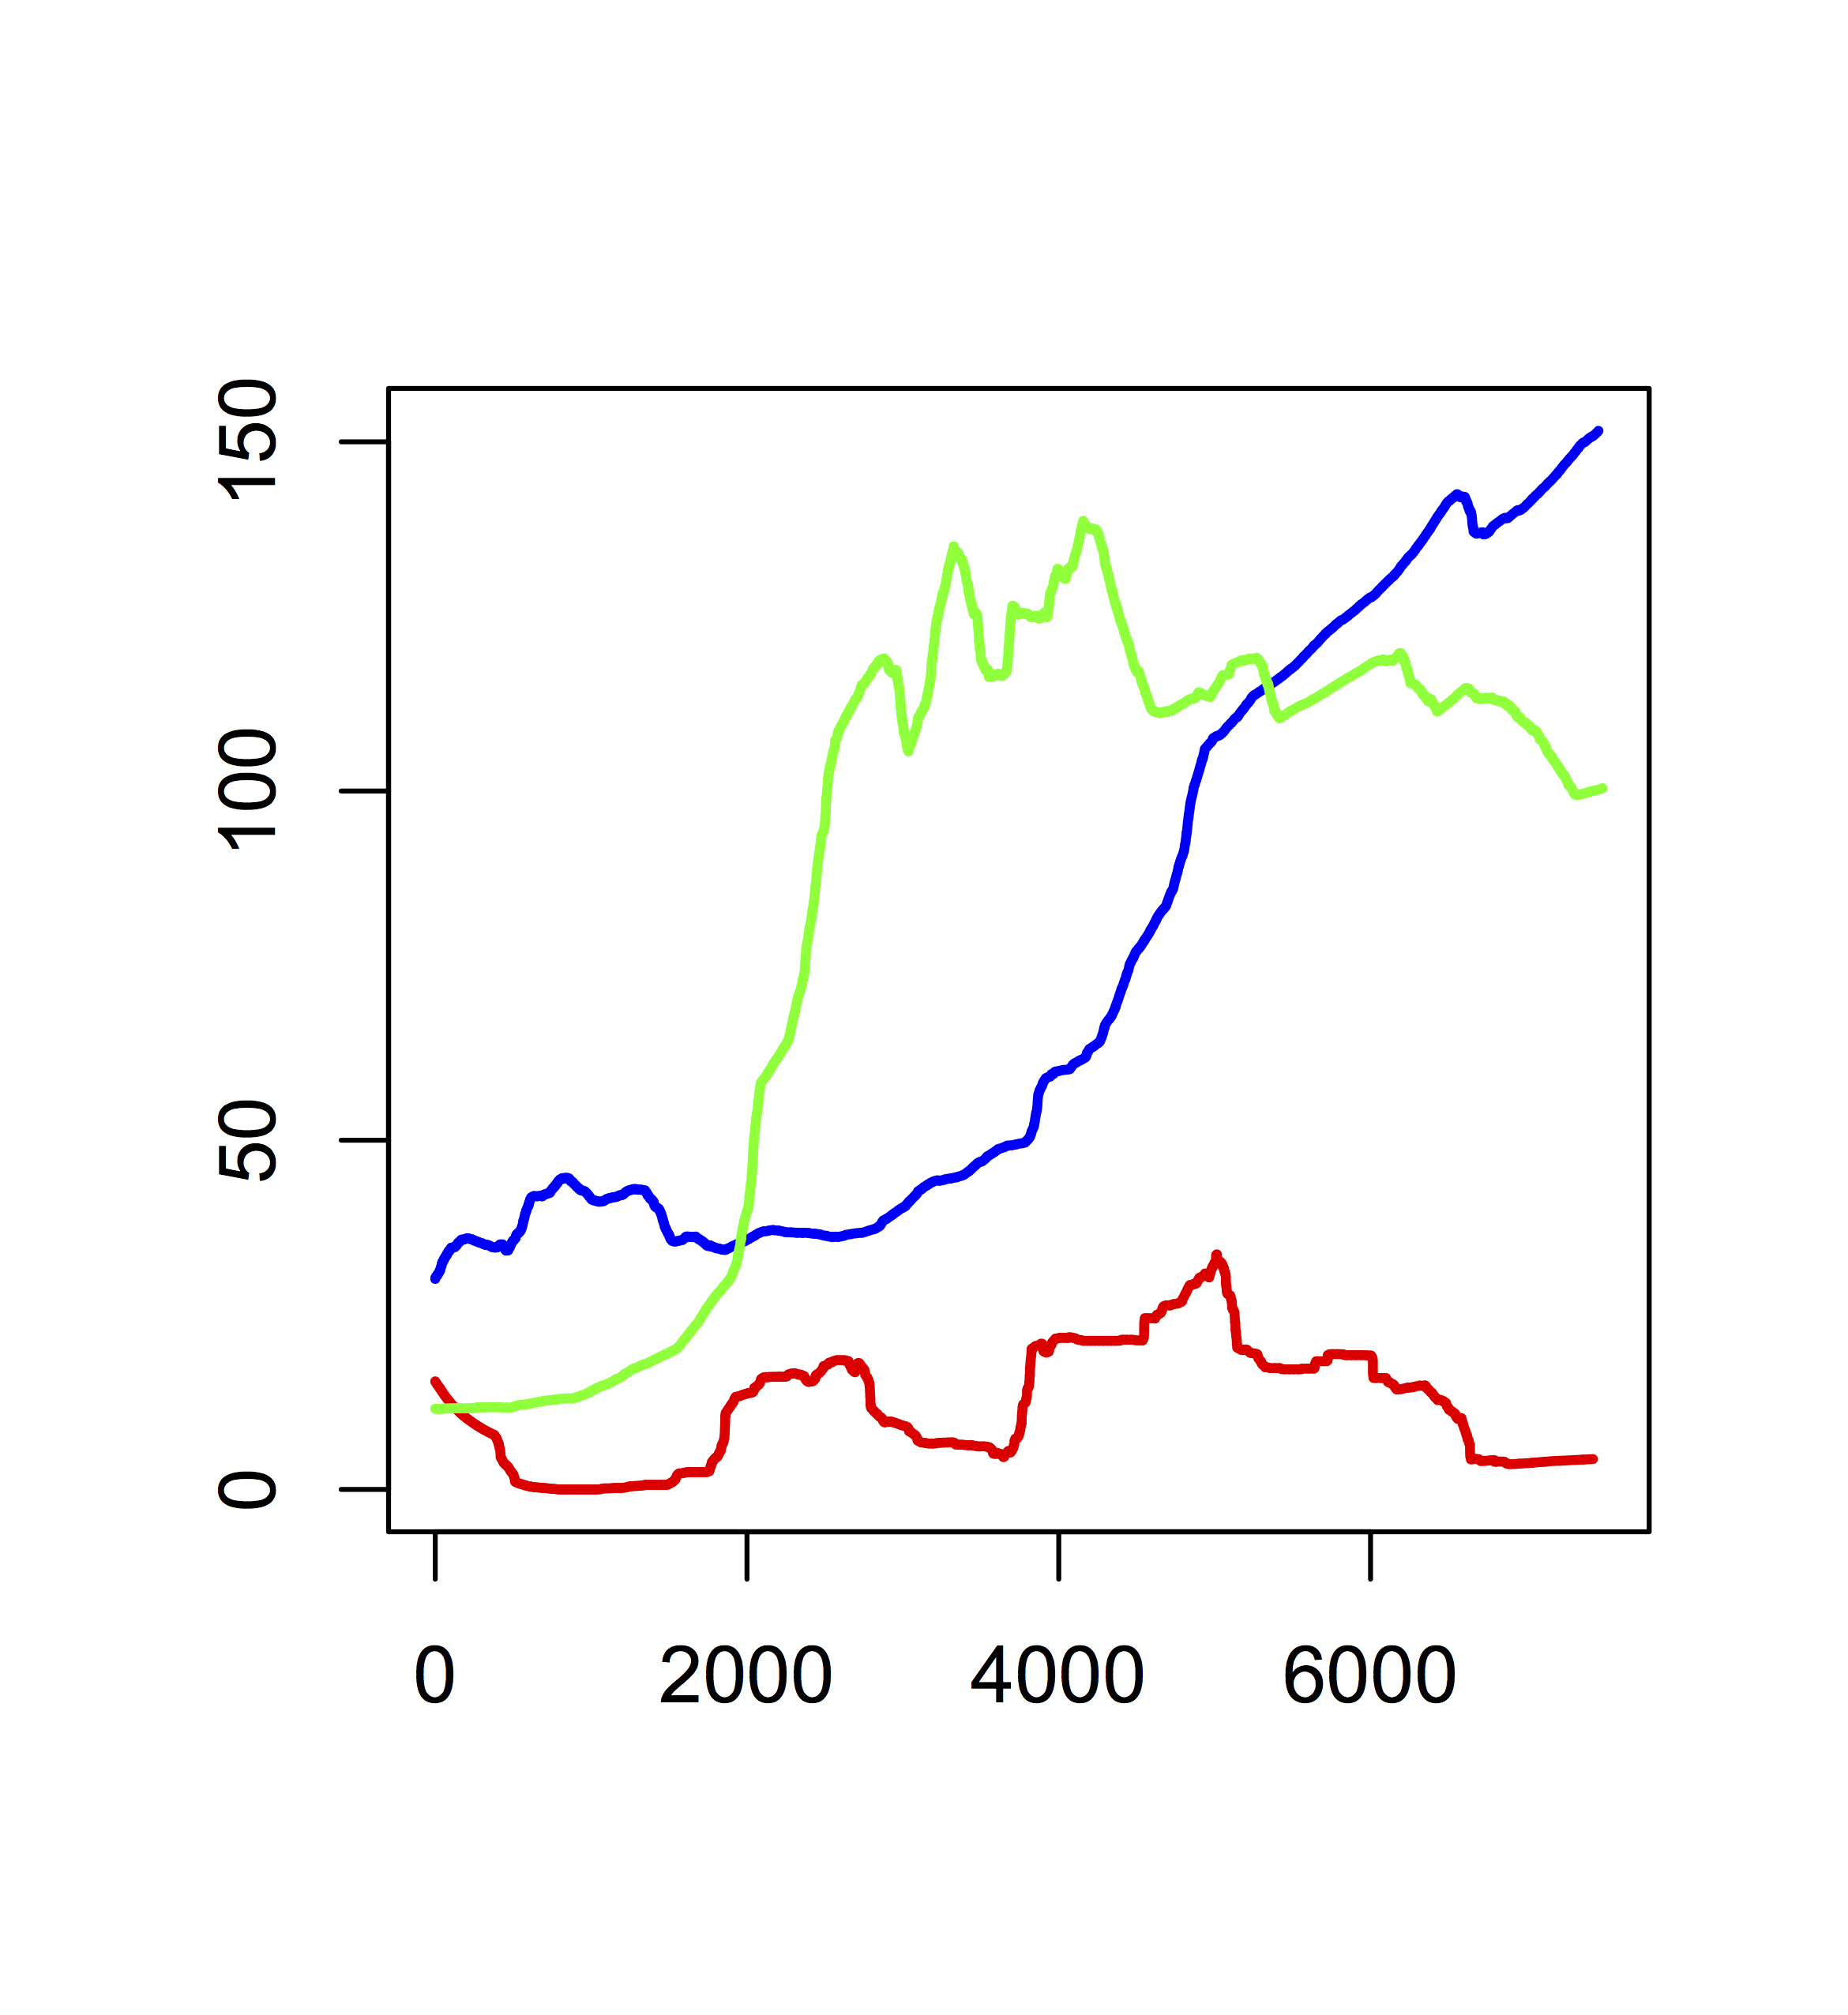
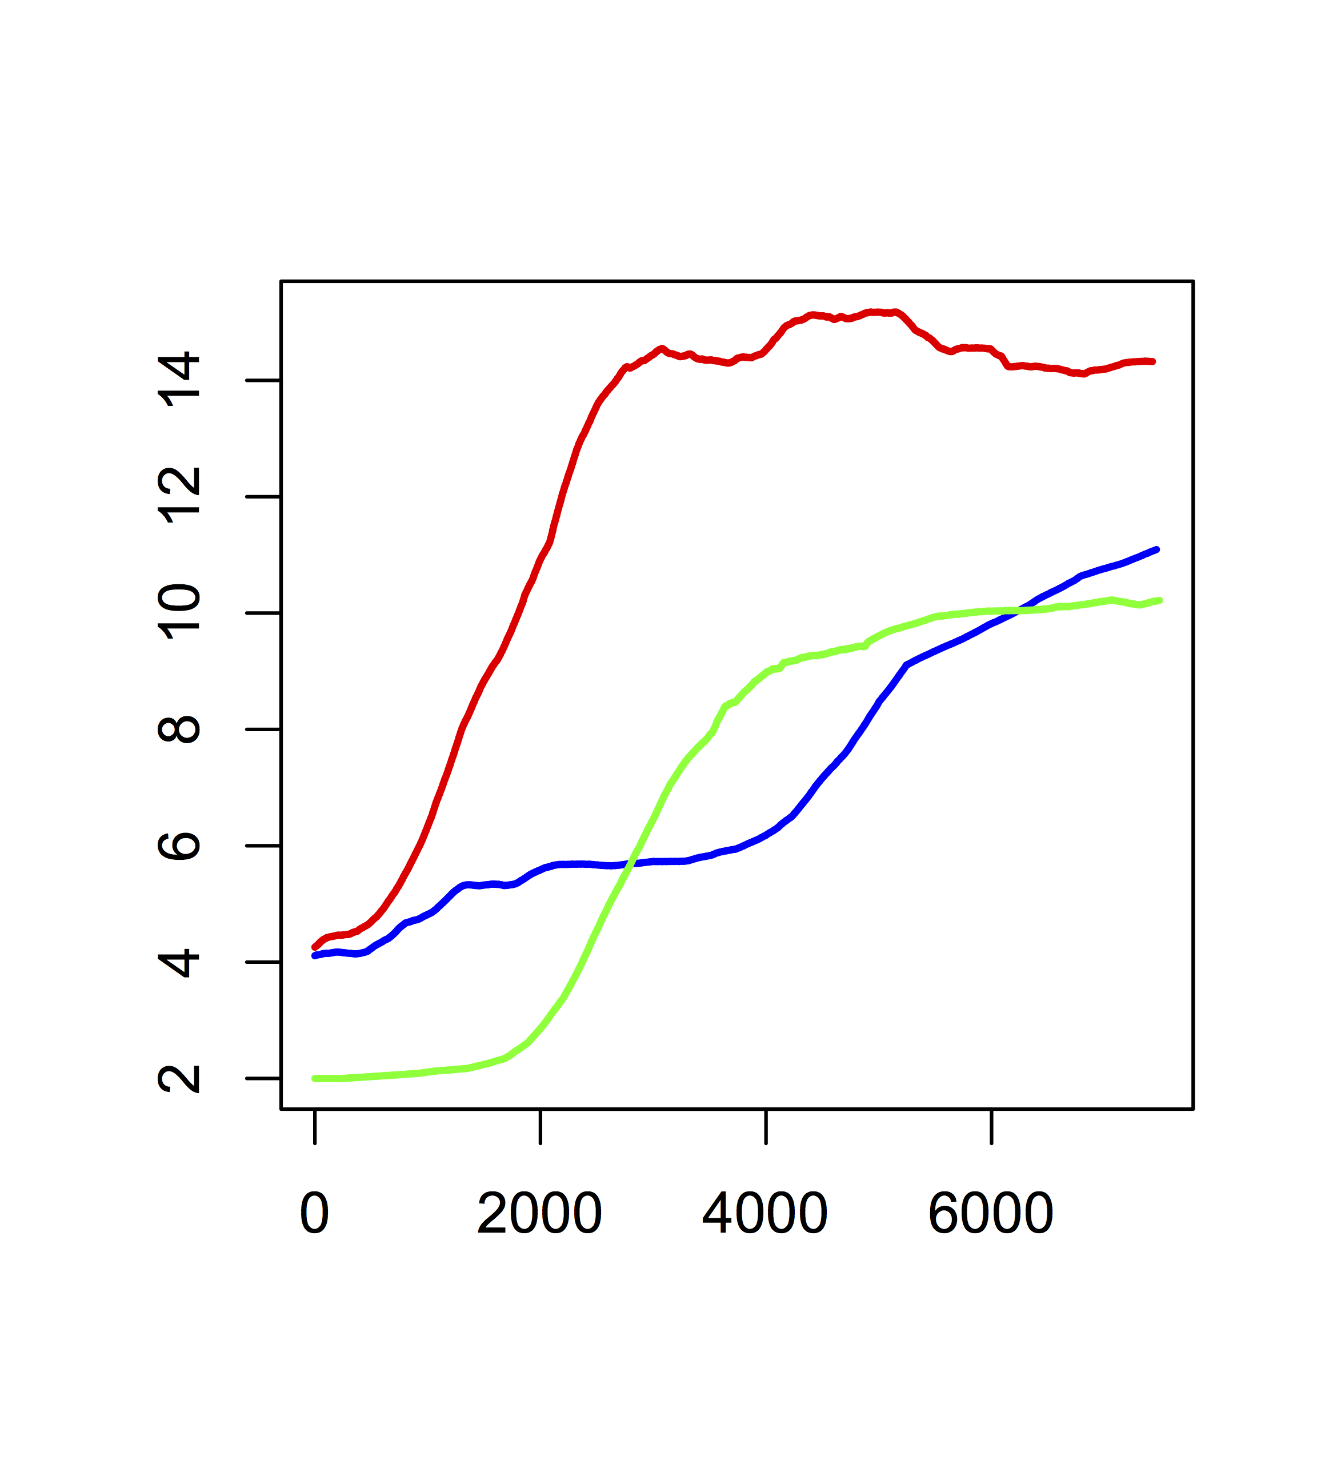
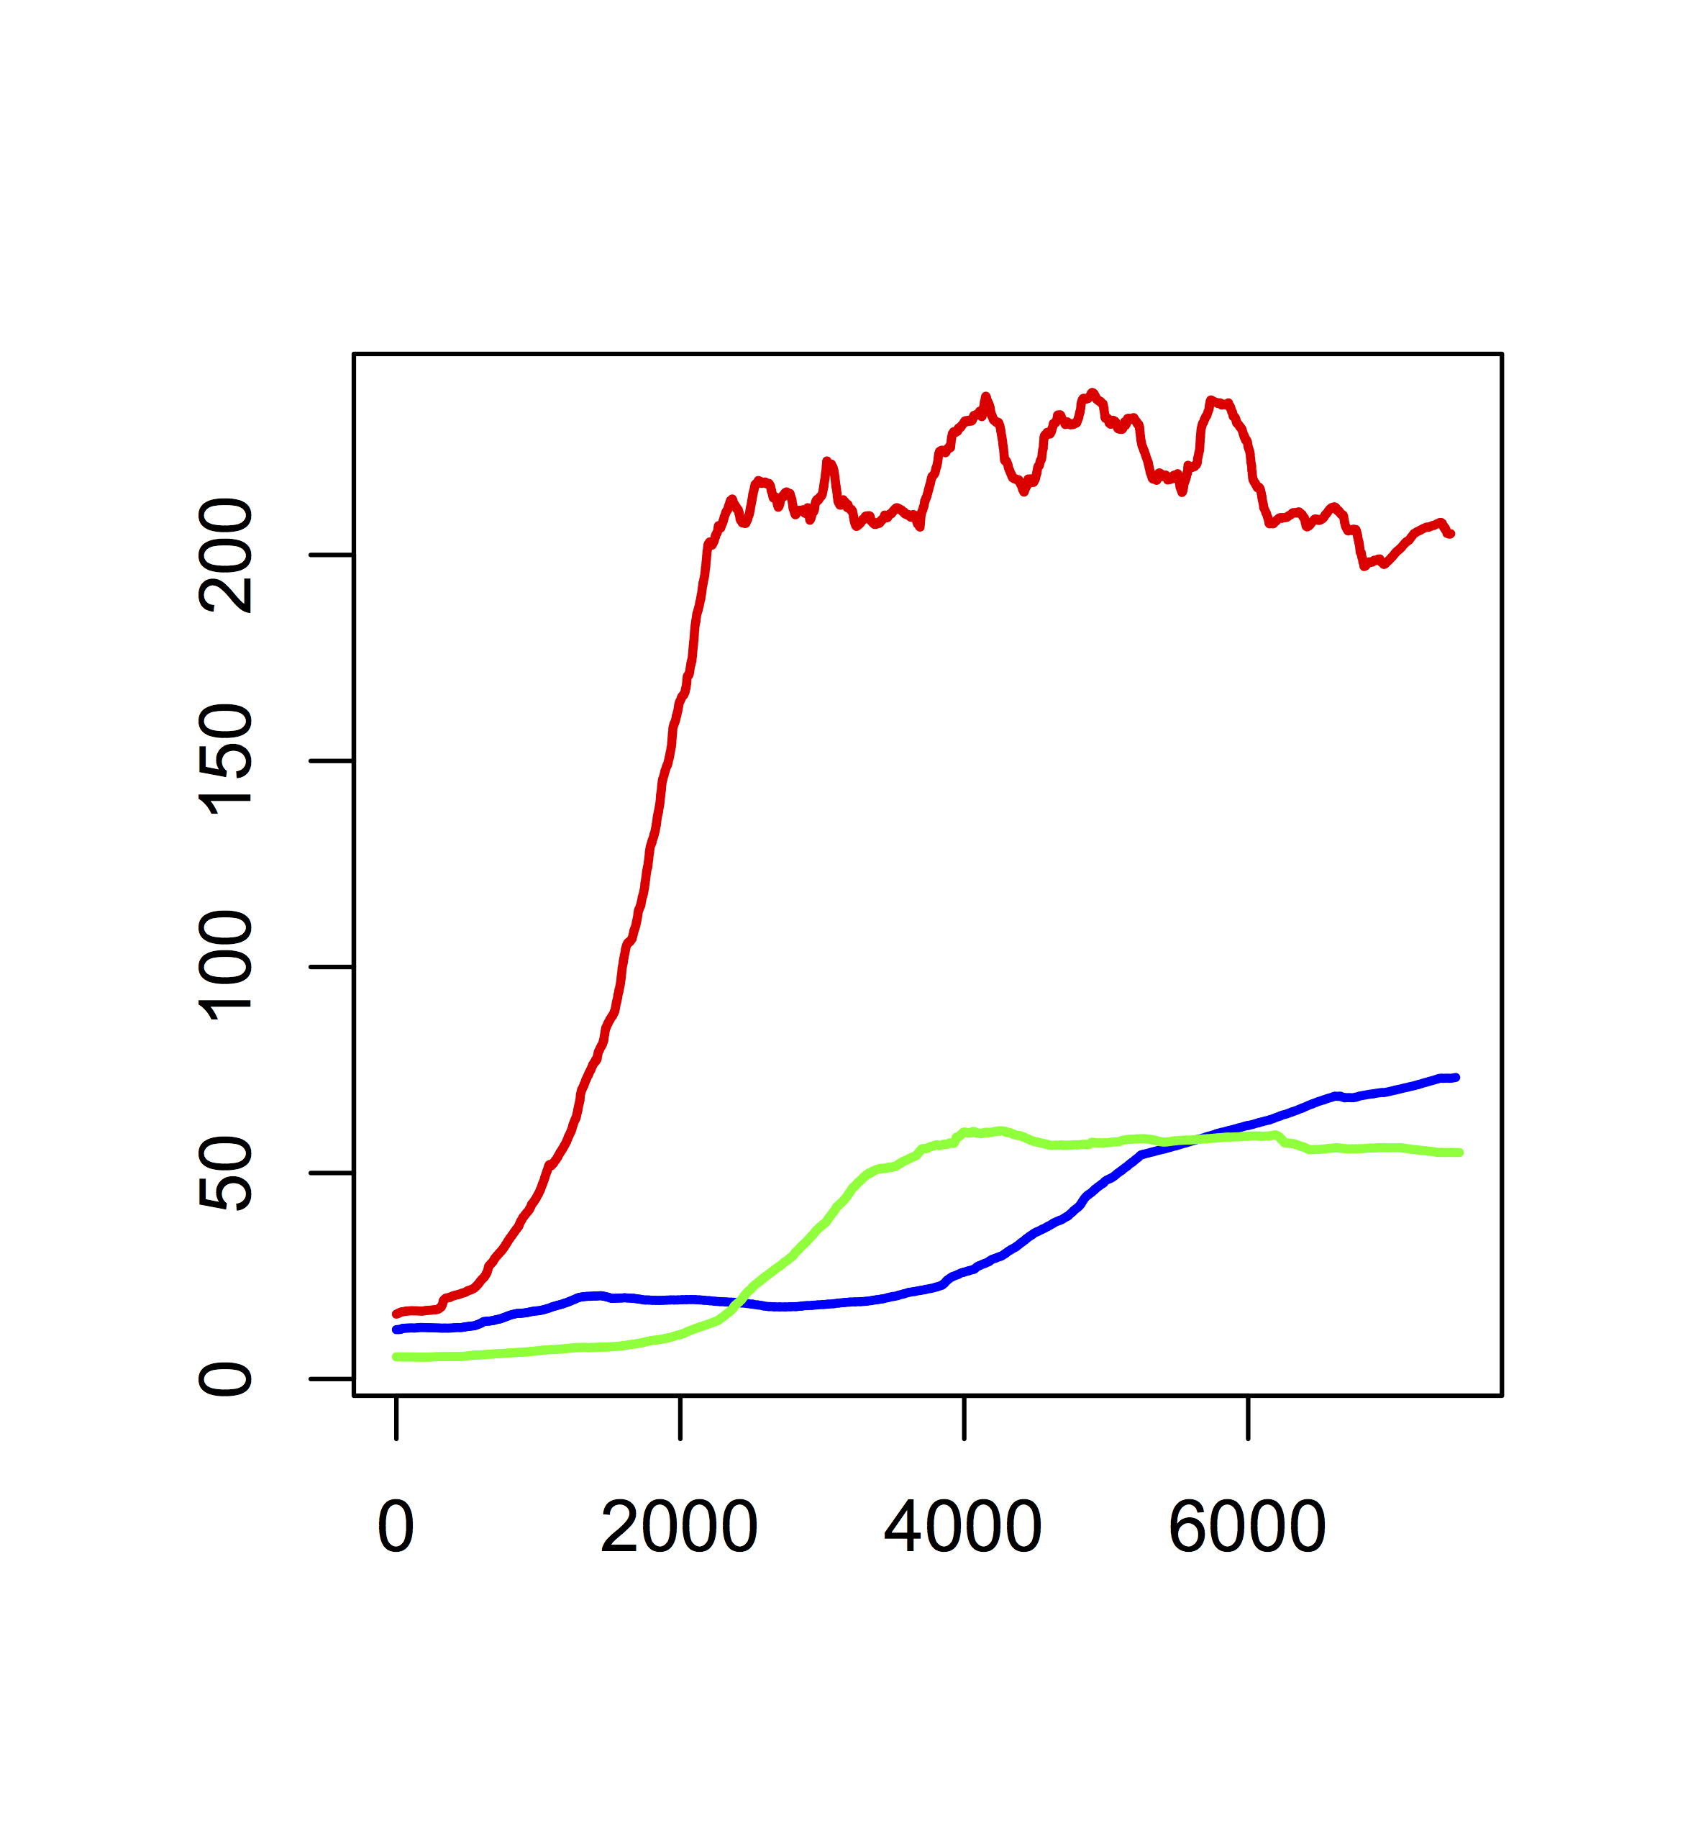
a. Mean number of
regulation network nodes
b. Mean number of
regulation network edges
Number of nodes
Number of edges
Generations
Generations
c. Mean number of
metabolic network nodes
d. Mean number of
metabolic network edges
Number of nodes
Number of edges
Generations
Generations

Slide 9
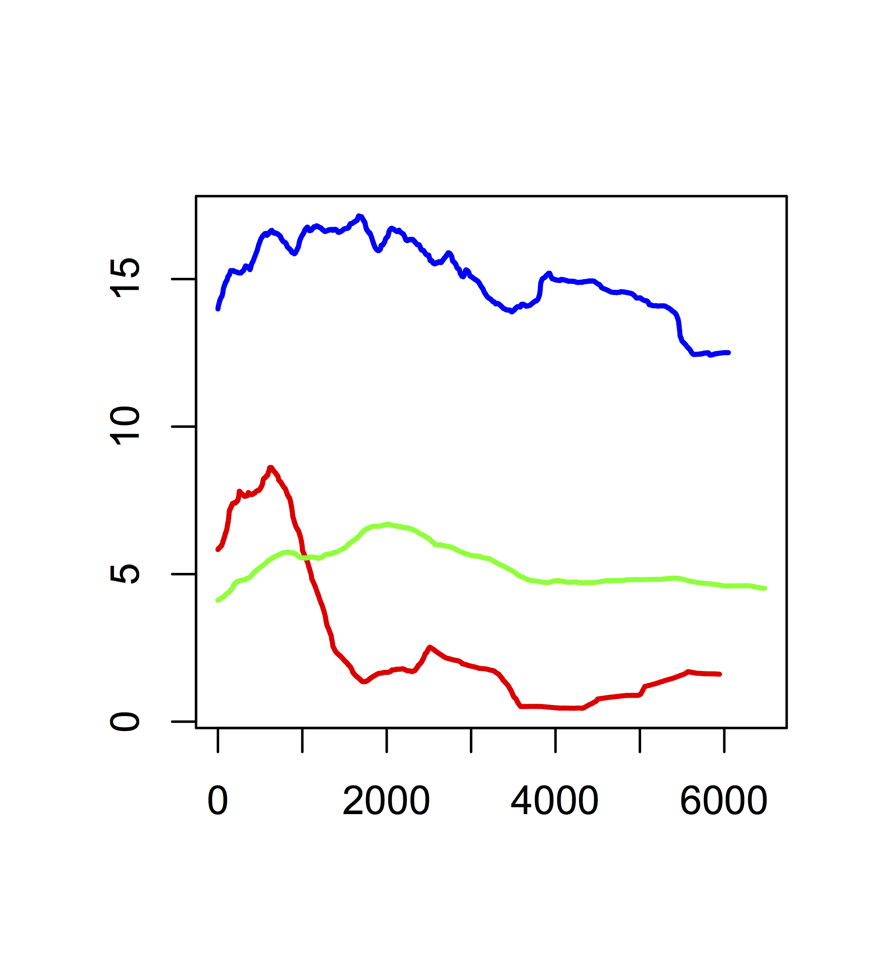
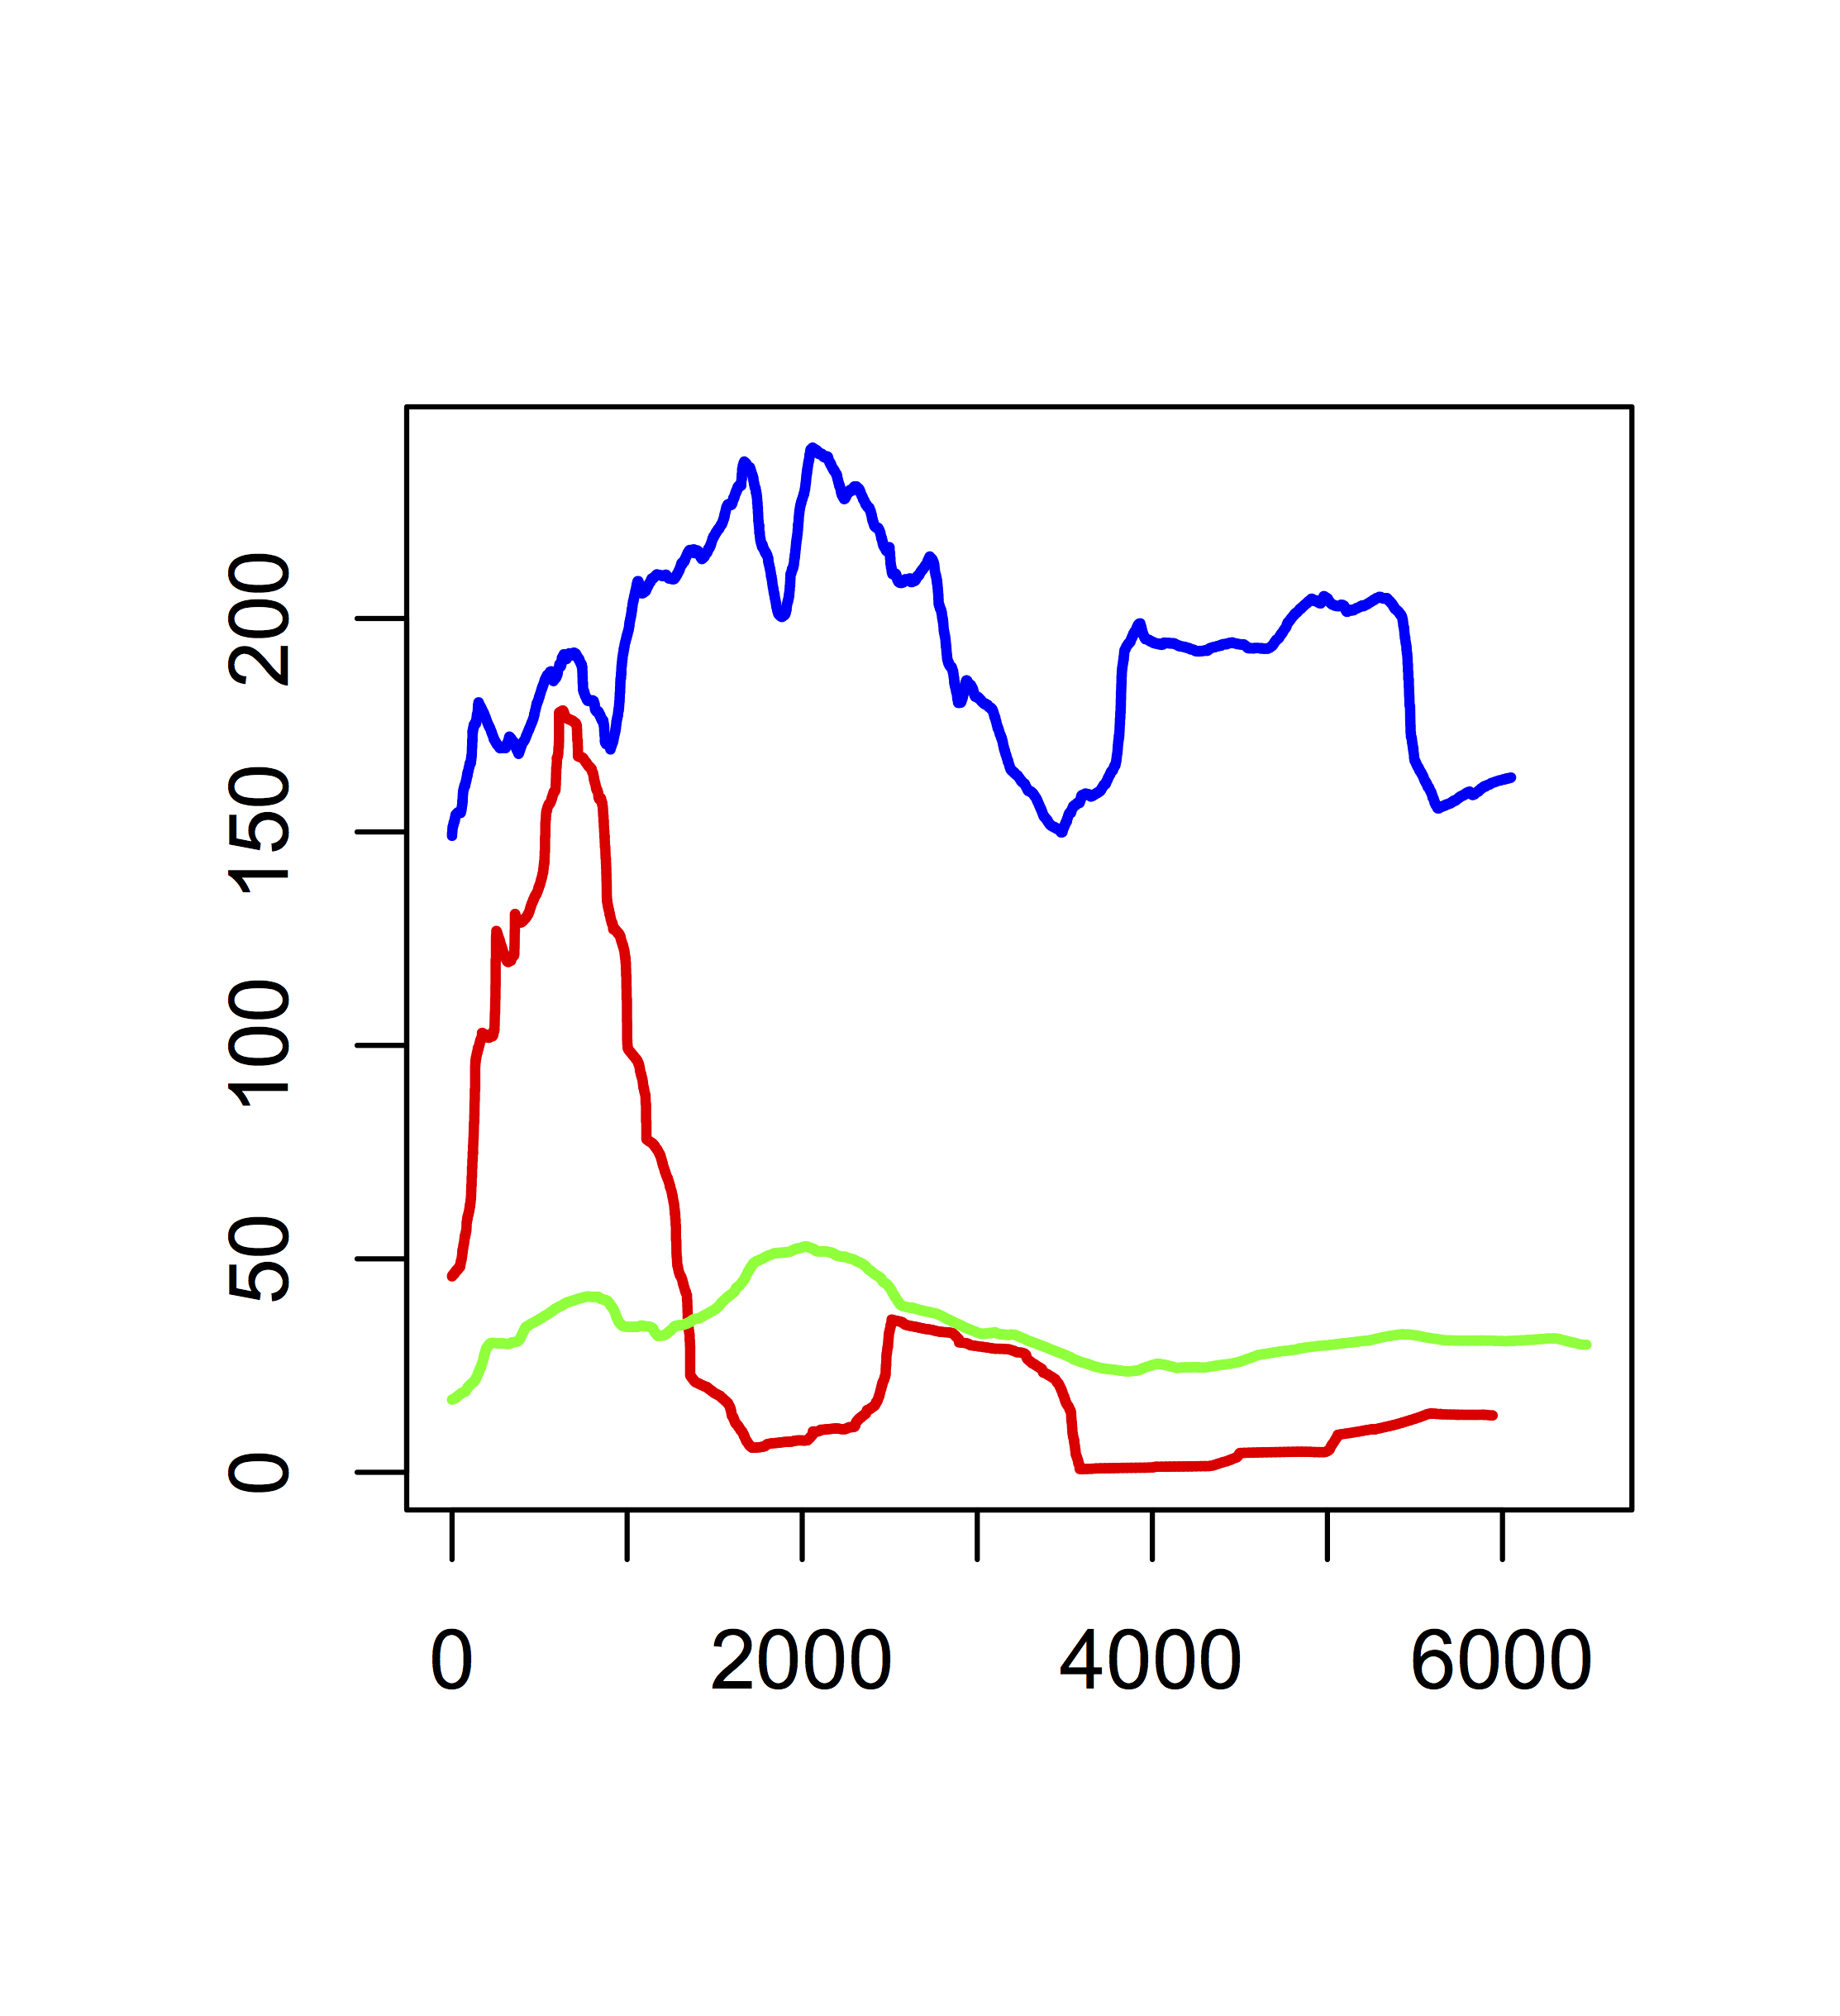
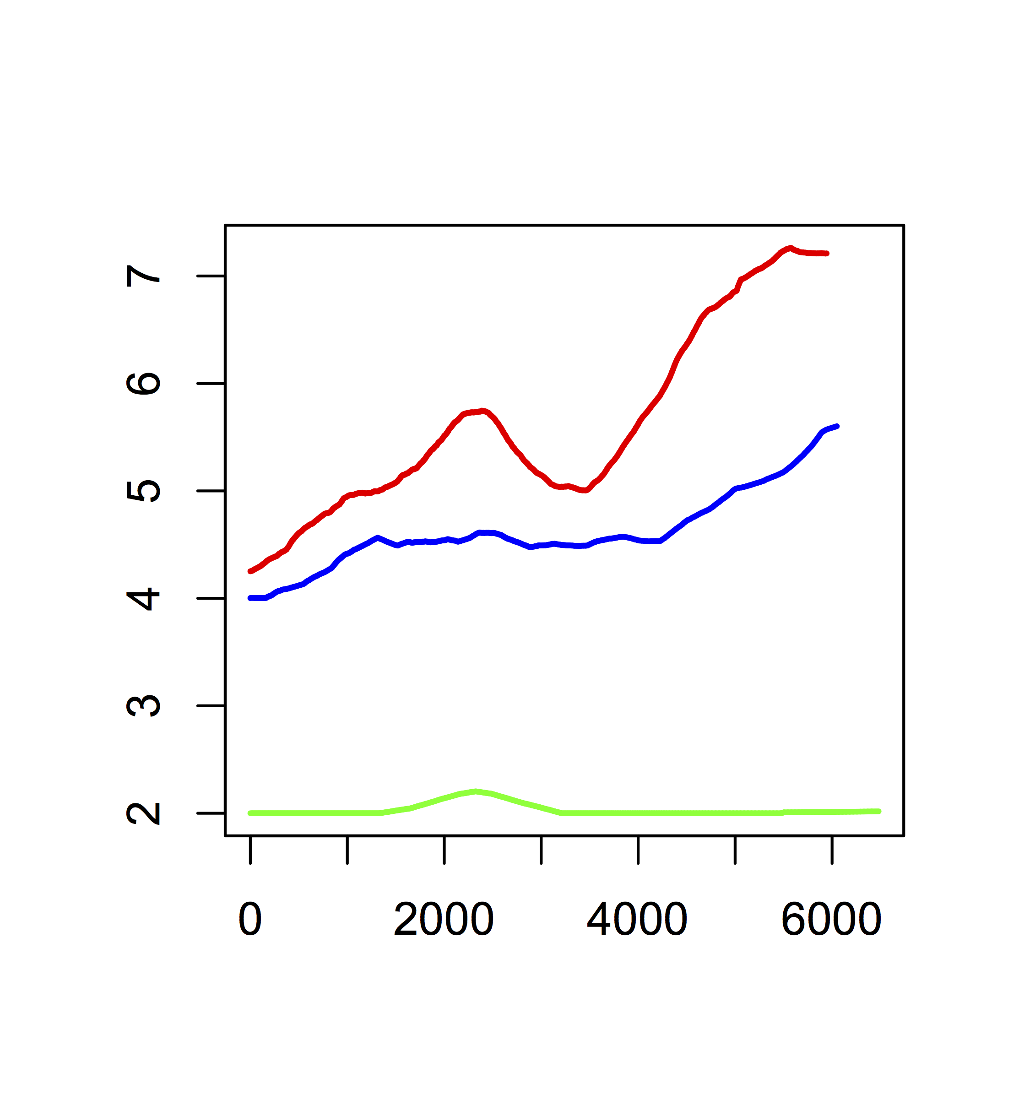
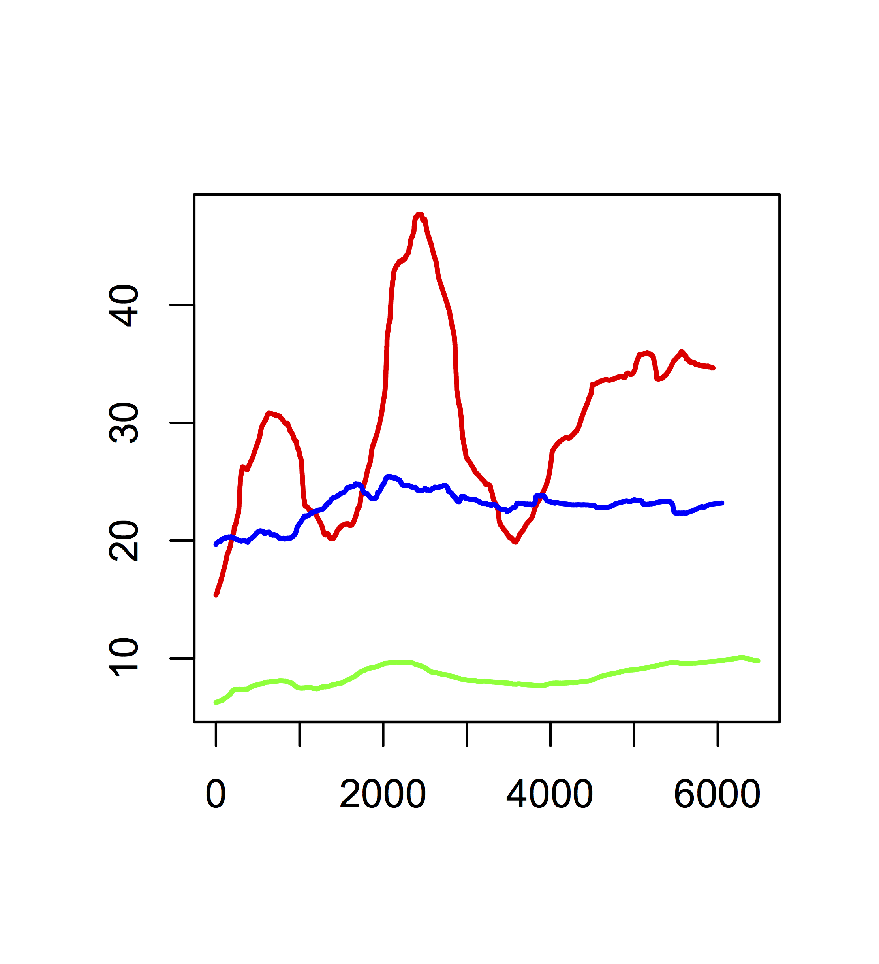
a. Mean number of
regulation network nodes
b. Mean number of
regulation network edges
Number of nodes
Number of edges
Generations
Generations
c. Mean number of
metabolic network nodes
d. Mean number of
metabolic network edges
Number of nodes
Number of edges
Generations
Generations

Slide 10
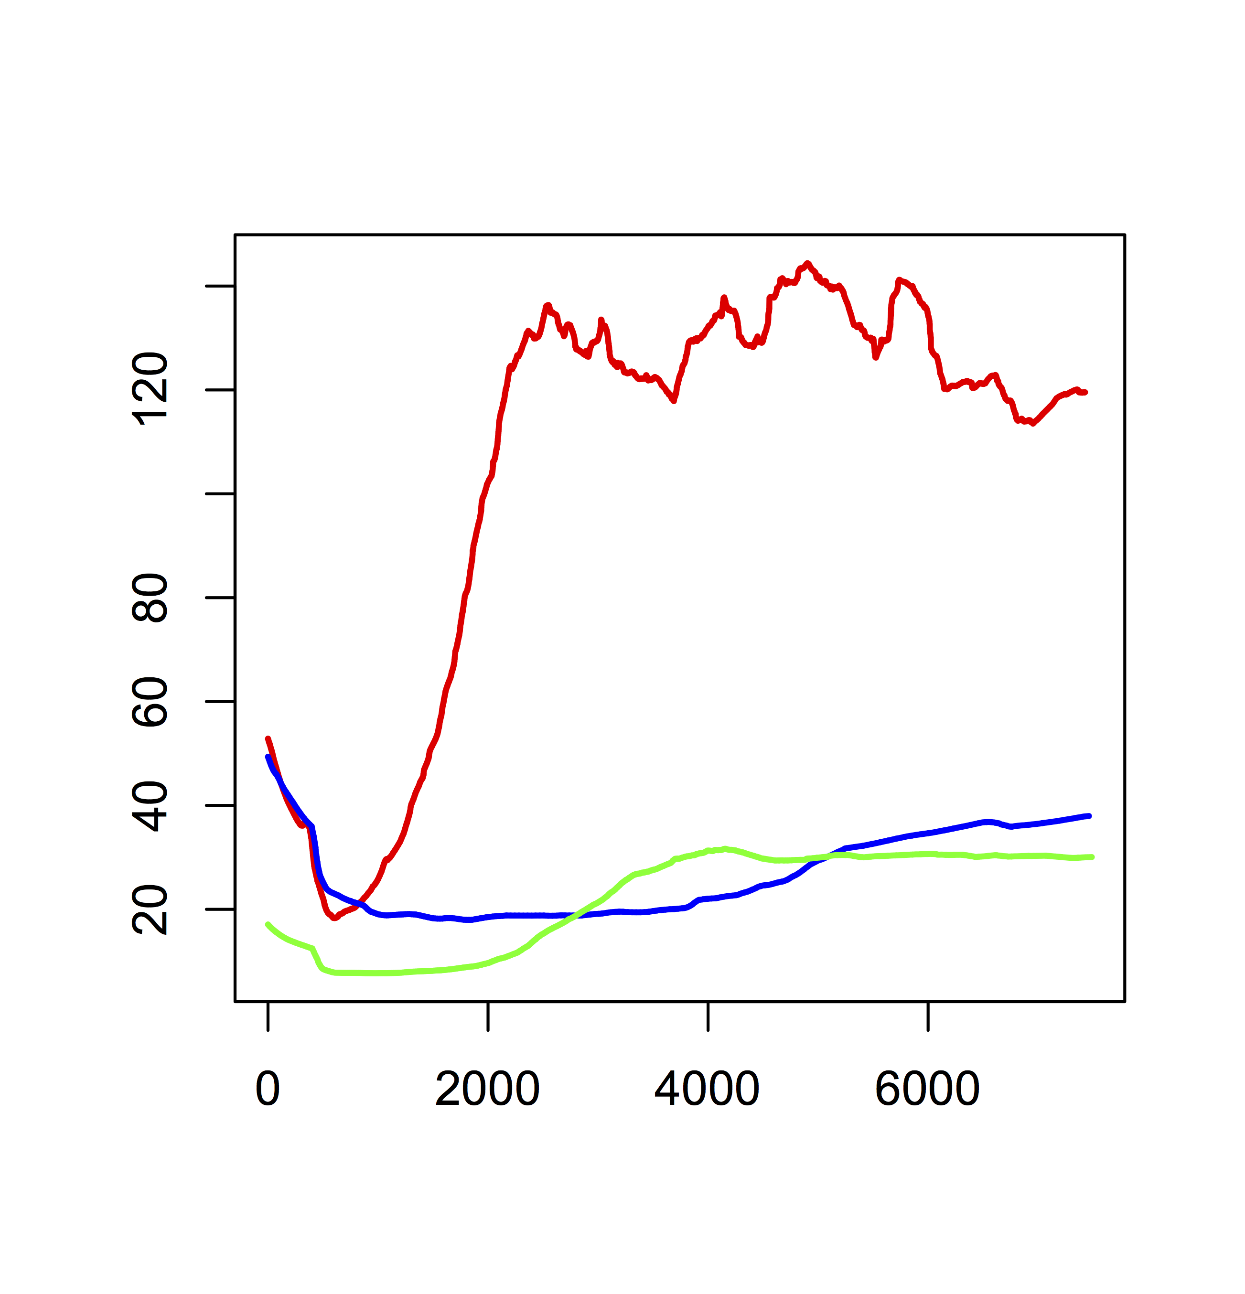
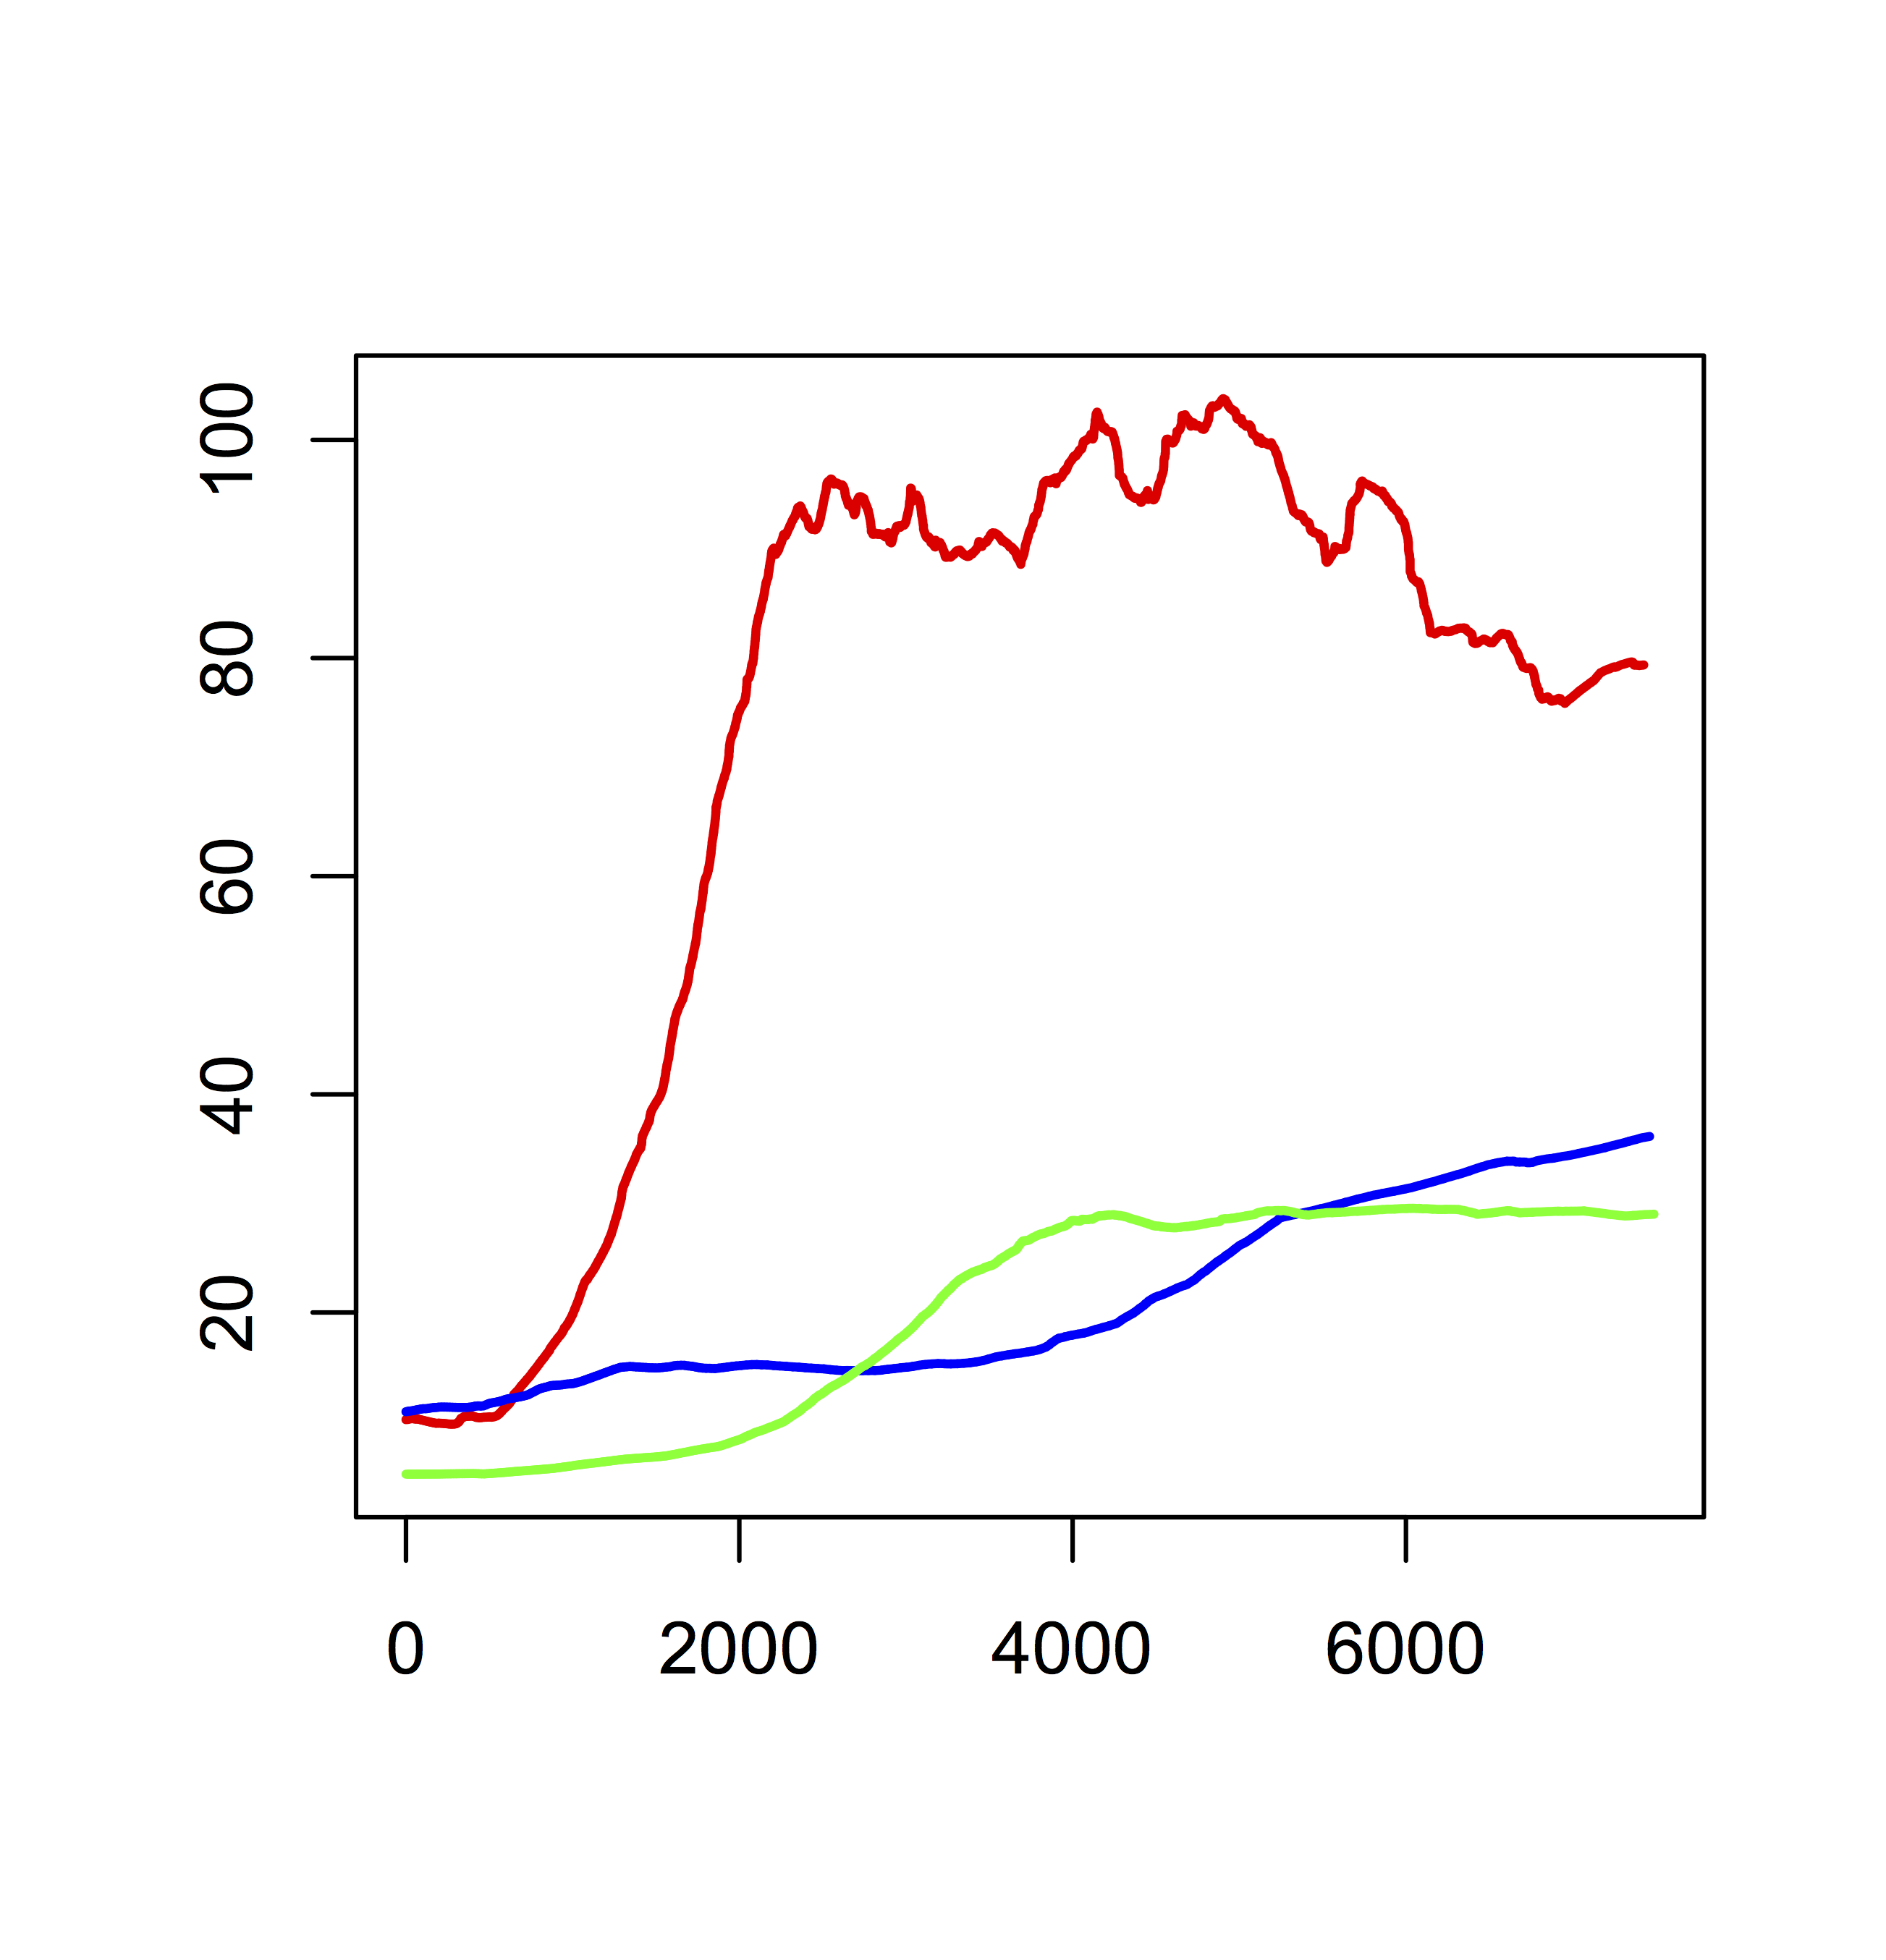
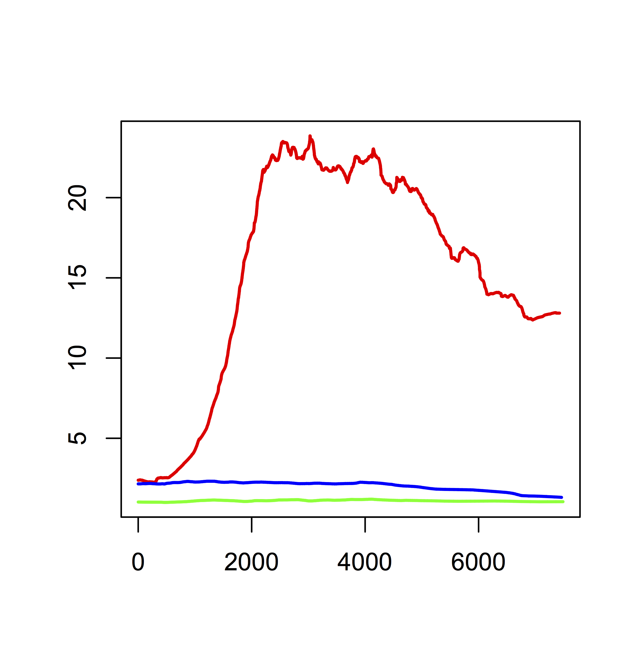
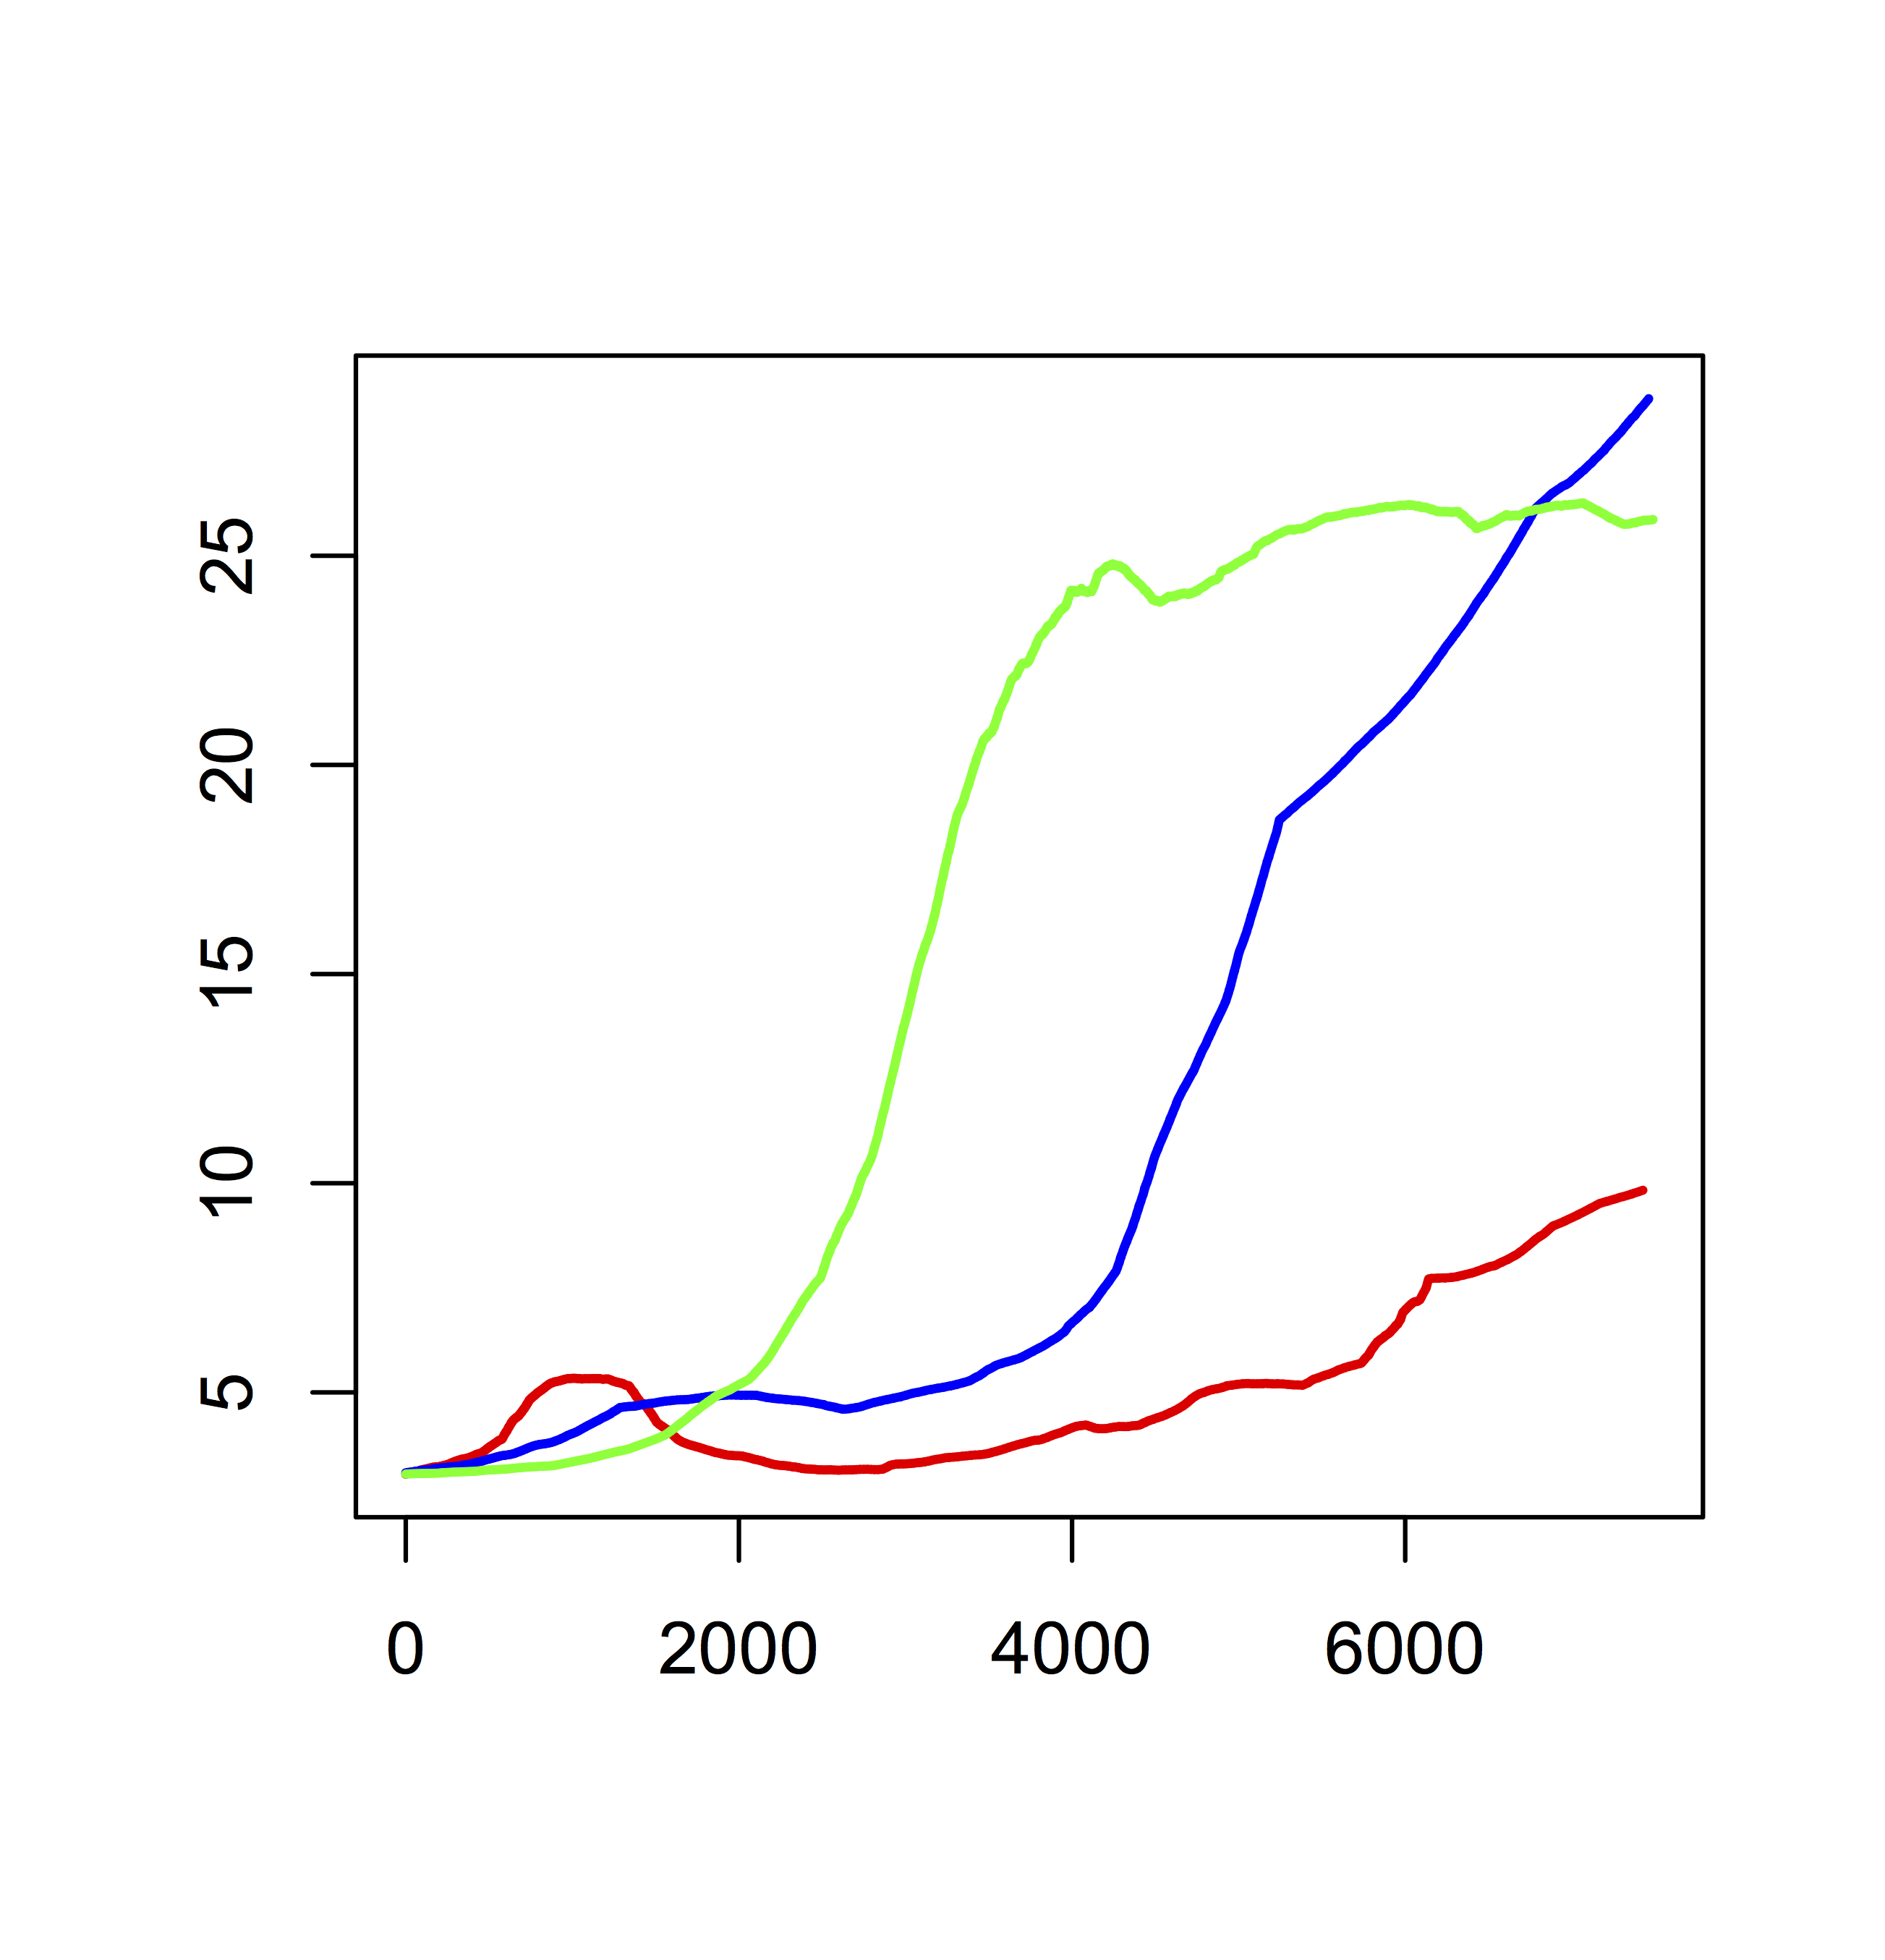
a. Mean genome size
b. Mean functional genome size
Number of genetic units
Number of genetic units
Generations
Generations
c. Mean number of functional regions
d. Mean operon size
Number of genetic units
Number of genetic units
Generations
Generations

Slide 11
Scenario
Consensus regulation network
under high mutation rates
Consensus regulation network
under low mutation rates
Environment A
No protein production cost
(genome A)
a.
b.
EMPTY
EMPTY
c.
d.
Environment A
Protein production cost
(genome A)
e.
f.
Environment B
Protein production cost
(genome B)

Slide 12
Scenario
Consensus metabolic network
under high mutation rates
Consensus metabolic network
under low mutation rates
Environment A
No protein production cost
a.
b.
Environment A
Protein production cost
c.
d.
Environment B
Protein production cost
e.
f.

Slide 13
a. Number of functional regions
b. Functional genome size
After this point,
the genome contains
a single operon
Generations
Generations
c. Number of nodes in the regulation network
d. Number of edges in the regulation network
Generations
Generations
e. Number of nodes in the metabolic network
f. Number of edges in the metabolic network
Generations
Generations

Slide 14
a. Genome structure
without protein production costs
1
2
9
b. Genome structure
with protein production costs
3
8
1
Repetition 6
60 genetic units
76.7% coding
4
Repetition 2
32 genetic units
90.6% coding
7
5
6

Slide 15
a. Genetic regulation network
b. Metabolic network

Slide 16
a. Cytoplasm’s metabolic content
Concentration (Z)
b. Local environment’s metabolic content
Concentration (Z)

Slide 17
a. Genome structure
b. Metabolic content of the cytoplasm
Concentration (Z)
40 genetic units
100% coding
d. Metabolic network
c. Genetic regulation network

